Slide 1
Inclusive and Equitable Teaching With Technology
Welcoming and Supporting All Our Students

Slide 2
Ask yourself
What one word describes how you feel about online teaching?

Slide 3
Other people help us be successful

Slide 4
Challenges
2 Theoretical Frameworks
6 Strategies
Questions and Discussion
2 More Theoretical Frameworks
6 More Strategies
Questions and Discussion

Slide 5
Challenges
Online teaching and learning

Slide 6
What do we know about online classrooms?

Slide 7
What we know about online students

Slide 8
Students in Spring 2020 felt disconnected
What we know
Notes:
15,000 students

Slide 9
What we know about online faculty

Slide 10
#1 challenge, Spring 2020: keeping students engaged
What we know
https://tytonpartners.com/library/time-for-class-covid19-edition-part-1/
Notes:
4,000 faculty at 1,500 schools

Slide 11
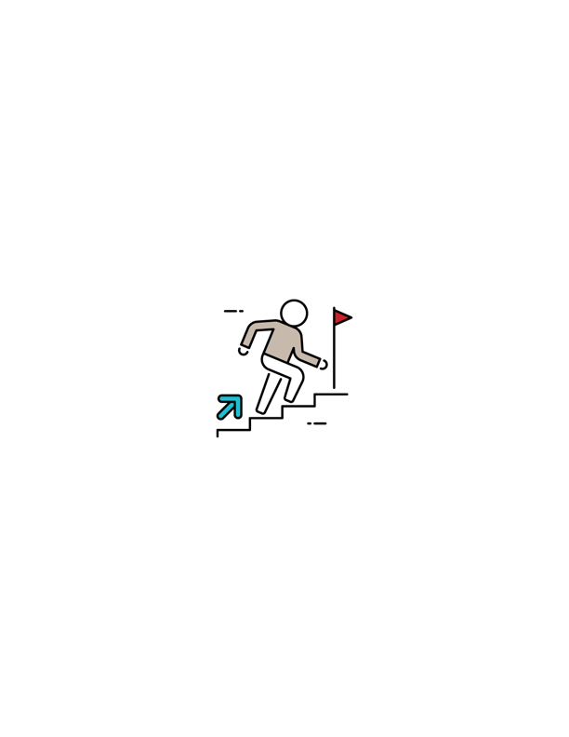
Connecting
with the people in our classes
Notes:
Social and emotional connections as a way to engage students, motivate them, and help them learn

Slide 13
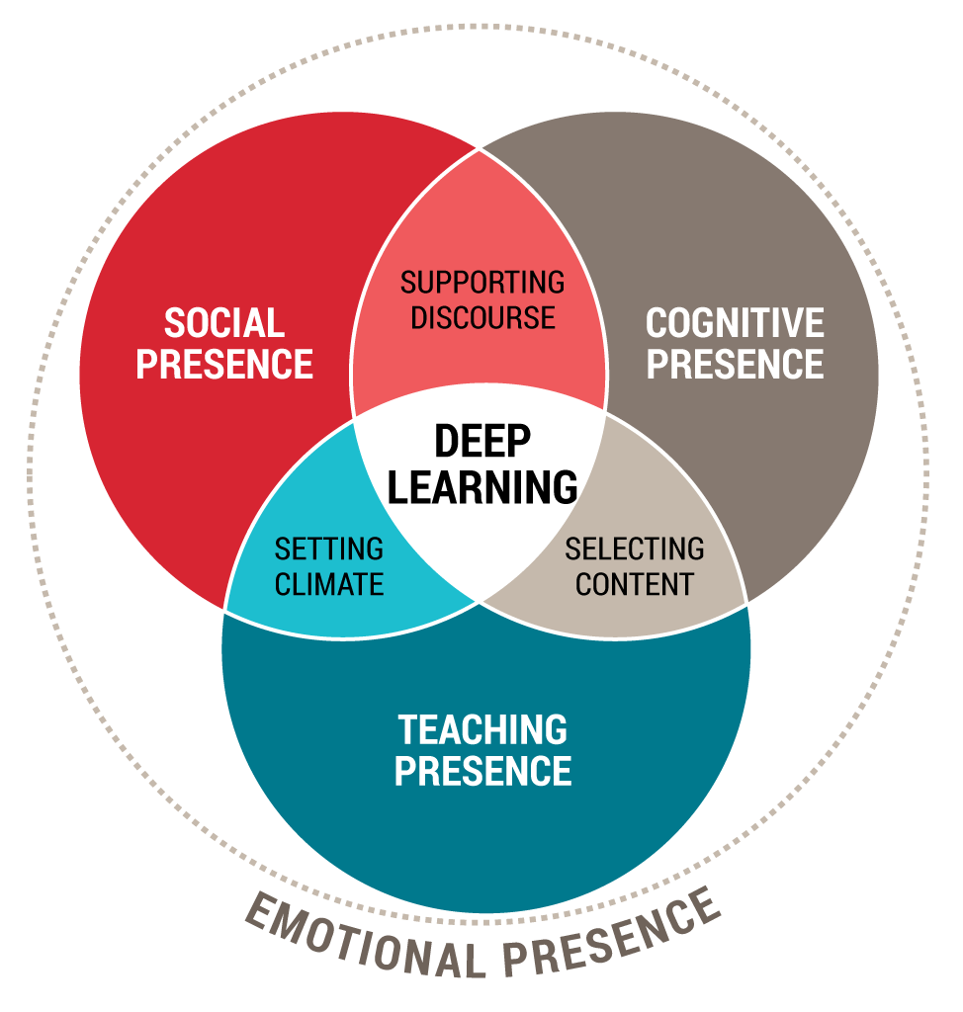
Modified Community of Inquiry
Framework

Slide 14
Universal Design for Learning
Framework

Slide 15
Offer
choice and options
where possible

Slide 16
UDL
+1 thinking
Thomas Tobin
University of Wisconsin Madison
Reach Everyone, Teach Everyone: Universal Design for Learning in Higher Education (2018)
Notes:
If I think you care about me more than you care about your content, the task, the deadline, then I will engage with you.

Slide 17
Harness the Science of Emotion
Attention
Memory
Motivation
Engagement
Sarah Rose Cavanagh
The Spark of Learning: Energizing the College Classroom with the Science of Emotion (2016)

Slide 18
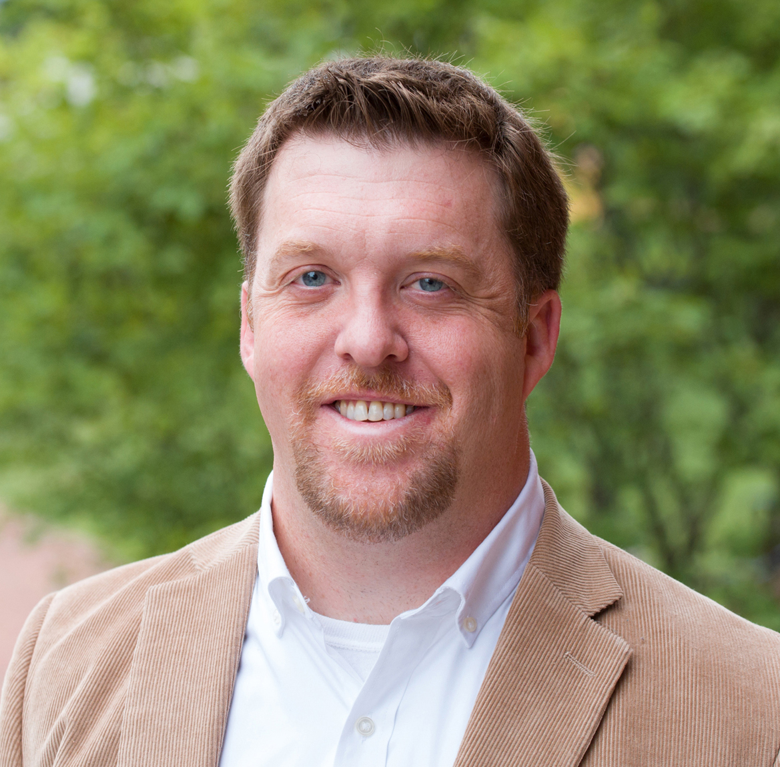
“
Our sociality drives our learning…
Joshua R. Eyler Author, How Humans Learn

Slide 19
5 Strategies
for all formats

Slide 20
Create a welcoming tone

Slide 21
Be vibrantly yourself

Slide 22
Bring your
passion
to create the atmosphere

Slide 23
Design
for emotion

Slide 24
Questions
and
discussion

Slide 25
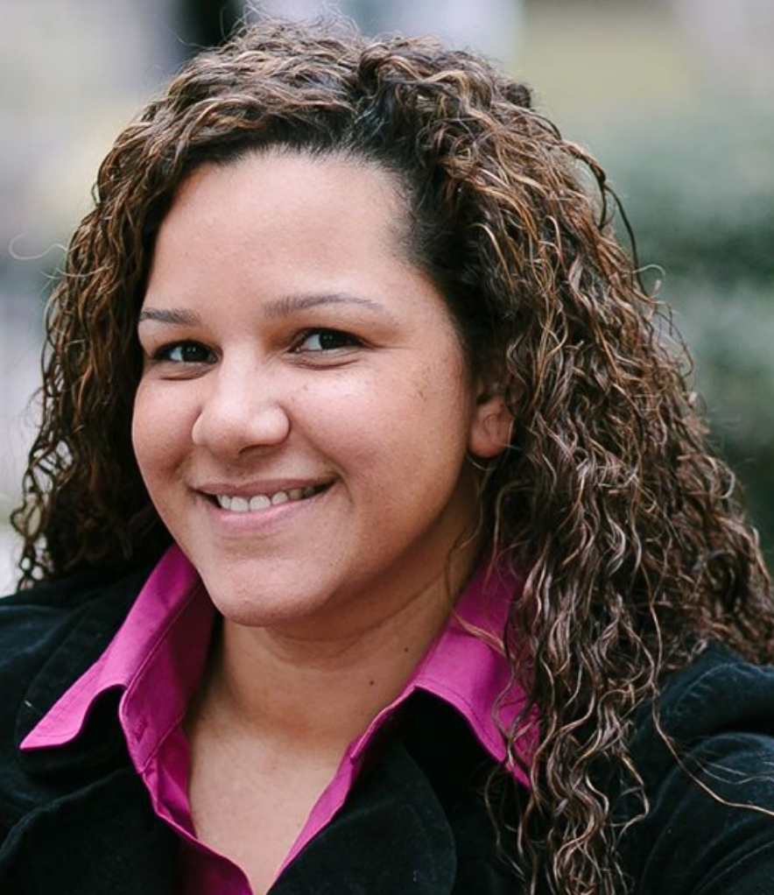
Culturally Responsive online Pedagogy
Courtney Plotts
National Chair of the Council For At-Risk Student Education and Professional Standards
Notes:
If I think you care about me more than you care about your content, the task, the deadline, then I will engage with you.

Slide 26
Photo by Karsten Würth on Unsplash
Photo by Chris Charles on Unsplash
Photo by Karim MANJRA on Unsplash
Photo by MIKHAIL VASILYEV on Unsplash
Photo by Andreas Weiland on Unsplash
Photo by Jamie Street on Unsplash
Notes:
Poll 1

Slide 27
Community
values setting
exercise

Slide 28
Frequent
messaging
about availability

Slide 29
Help Students Make Connections
“… a vast amount of closet space…”
Michelle Miller
Minds Online: Teaching Effectively With Technology (2014)

Slide 30
Activate
prior knowledge
or experience

Slide 31
Provide the
framework

Slide 32
Assess
early and often

Slide 33
Ask yourself
What one word describes how you feel about online teaching?

Slide 34
Questions
and
discussion

Slide 35
Special Thanks
Graphic Design by
That’s Smart Designs

